Slide 1
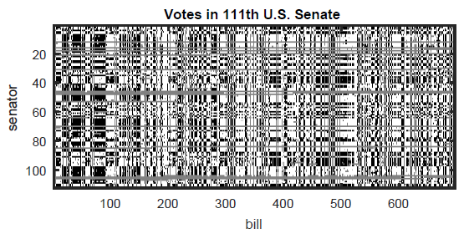
Chapter 7 Matrix Analysis

Slide 2
Section 7.1 From matrix to insight

Slide 3
From matrix to insight
Any two-dimensional array of numbers may be interpreted as a matrix
These may come from widely disparate tasks
Examples:
Text/document search
Voting patterns
Preferences/ratings
Graphs
Networks: social, political, co-authorship, casting in movies,…
Images

Slide 4
Examples of matrices
A term-document matrix may be used for analyzing a body of documents (or corpus)
Each column may be a document; each row a term
E.g, your textbook may have words like “numerical,” “discretization,” “matrix,” “integration” and “function”
An analysis textbook may have words like “integration,” “function,” “continuous” and so forth
The occurrence of “function” may be often in both books, but the other terms are likely to be much different in frequency
Meaning could be inferred from this kind of approach: latent semantic analysis

Slide 5
Examples of matrices
A term-document matrix example: matrix in green
Term | FNC by TAD+RJB | Analysis by Rudin | SM by Trefethen | NYT coffee table book
Numerical | 251 | 2 | 179 | 0
Integration | 37 | 275 | 33 | 18
Function | 175 | 345 | 123 | 0
Matrix | 151 | 11 | 87 | 0
Continuous | 15 | 212 | 11 | 0
Spectral | 15 | 0 | 124 | 0
Citizen | 0 | 0 | 0 | 13

Slide 6
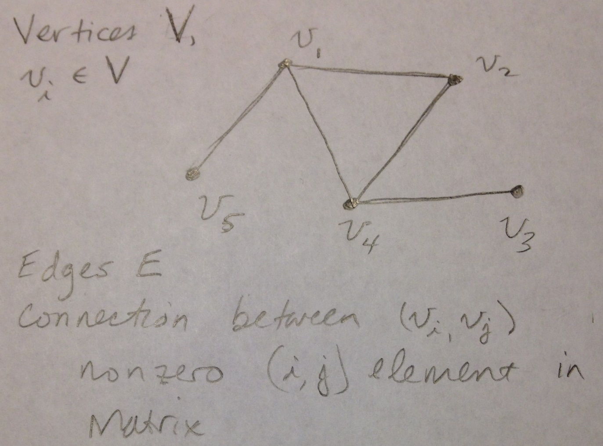
Graphs as matrices
Could be social network, internet (or subset of it), the web, etc
Consider graphs first
A graph is a set of nodes V connected by set of edges E
Sometimes the graph is denoted G(V,E)

Slide 7
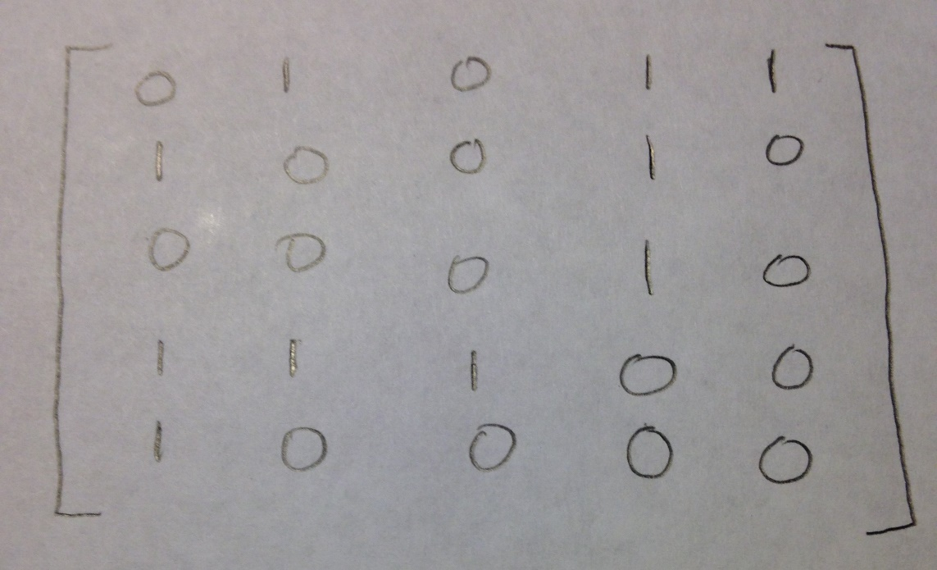
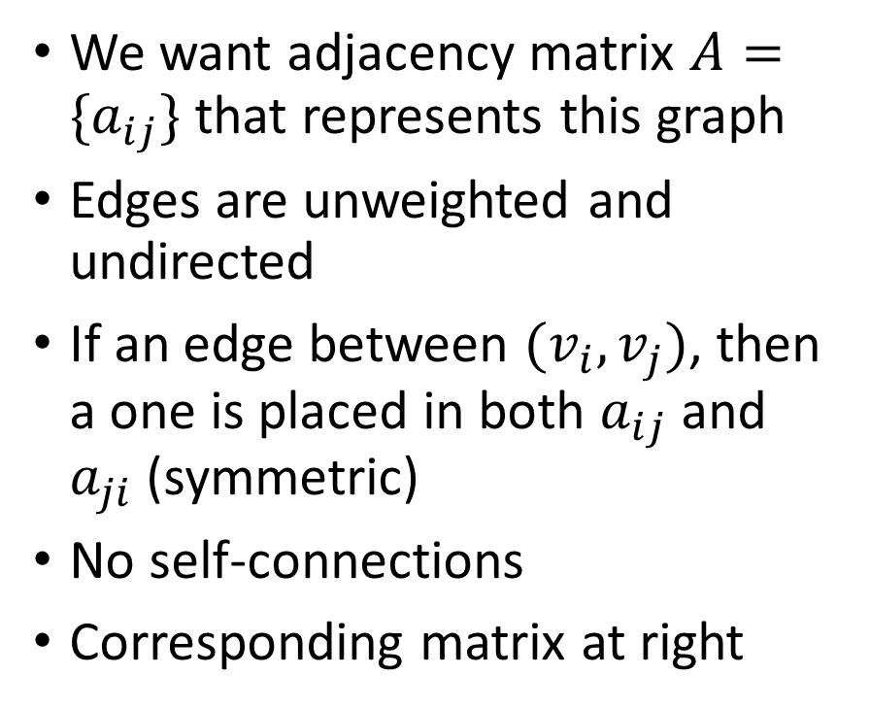
Adjacency matrix
We want adjacency matrix $A=\{a_{ij}\}$that represents this graph
Edges are unweighted and undirected
If an edge between $(v_{i},v_{j})$, then a one is placed in both $a_{ij}$ and $a_{ji}$ (symmetric)
No self-connections
Corresponding matrix at right

Slide 8
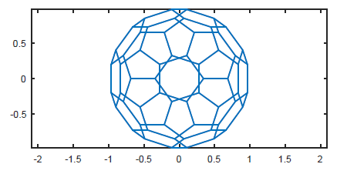
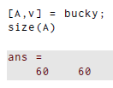
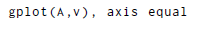
Adjacency matrix: Buckyball
Matlab has a built-in example of a graph representing the arrangements of carbon atoms in a C₆₀ molecule, a.k.a. the buckyball:
The output has the adjacency matrix A and the vertex locations v
Plotting the graph:

Slide 9
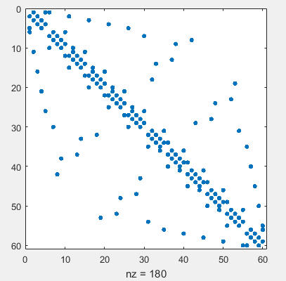
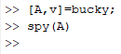
Adjacency matrix: Buckyball
We know there are 60 nodes; how many edges?
There is more than one way to compute this
For undirected, you could use the spy command:
Is nnz it? Not quite
You could use the triu and sum commands; how?

Slide 10
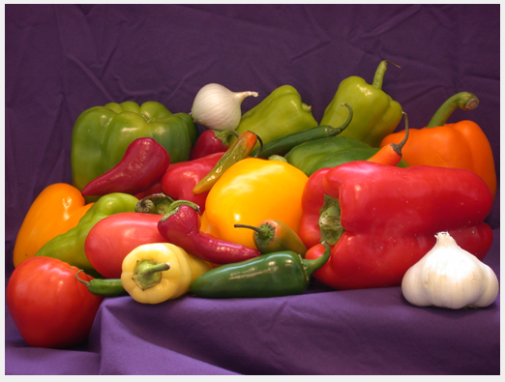
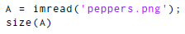

Images
Pictures and images are matrices in matlab
Use imread and imshow to display them
Three “layers” are RGB components
To display: imshow(A)

Slide 11
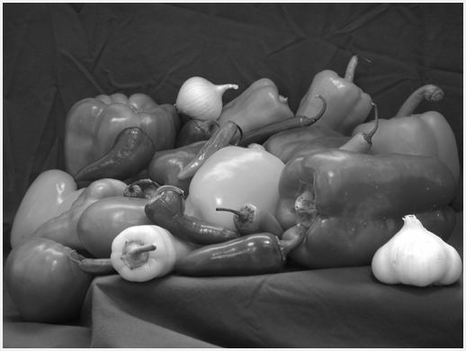
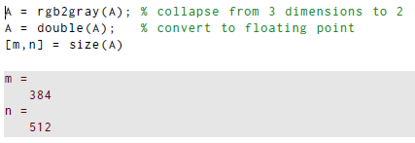
Images
We can convert to grayscale to get only a 2D matrix
Use rgb2gray and double:
To display: imshow(A,[0,255])
What if different range spec’d?

Slide 12
Section 7.2 Eigenvalue decomposition

Slide 13
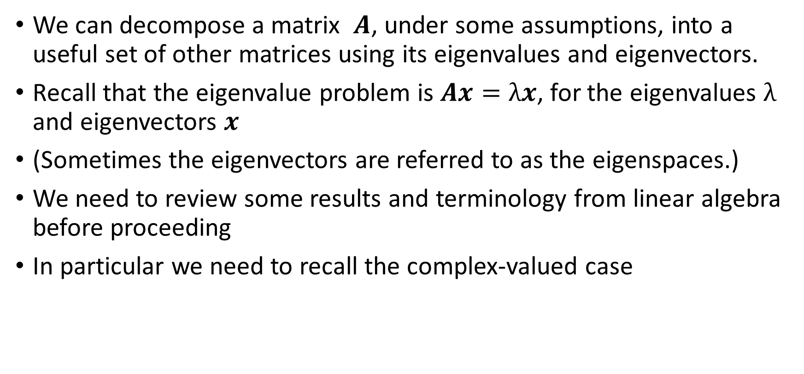
The eigenvalue decomposition
We can decompose a matrix $A$, under some assumptions, into a useful set of other matrices using its eigenvalues and eigenvectors.
Recall that the eigenvalue problem is $Ax=λx$, for the eigenvalues $λ$ and eigenvectors $x$
(Sometimes the eigenvectors are referred to as the eigenspaces.)
We need to review some results and terminology from linear algebra before proceeding
In particular we need to recall the complex-valued case

Slide 14
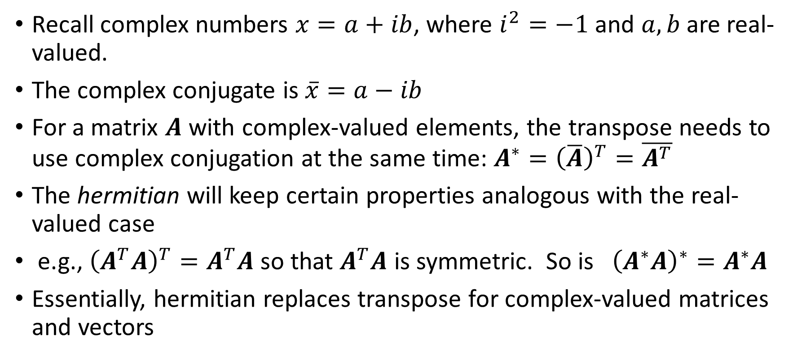
Complex vectors and matrices
Recall complex numbers $x=a+ib$, where $i^{2}=−1$and $a,b$ are real-valued.
The complex conjugate is $\overline{x}=a−ib$
For a matrix $A$ with complex-valued elements, the transpose needs to use complex conjugation at the same time: $A^{∗}={\left(\overline{A}\right)}^{T}=\overline{A^{T}}$
The hermitian will keep certain properties analogous with the real-valued case
e.g., ${\left(A^{T}A\right)}^{T}=A^{T}A$ so that $A^{T}A$ is symmetric. So is ${\left(A^{∗}A\right)}^{∗}=A^{∗}A$
Essentially, hermitian replaces transpose for complex-valued matrices and vectors

Slide 15
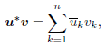
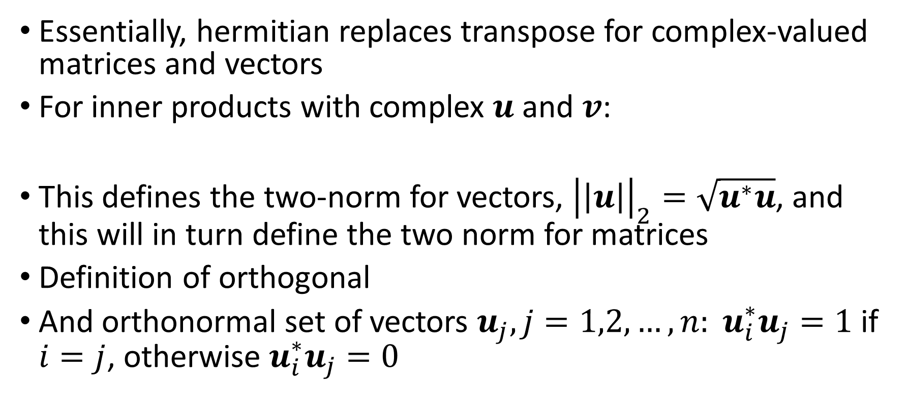
Complex vectors and matrices
Essentially, hermitian replaces transpose for complex-valued matrices and vectors
For inner products with complex $u$ and $v$:
This defines the two-norm for vectors, ${\left|\left|u\right|\right|}_{2}=\sqrt{u^{∗}u}$, and this will in turn define the two norm for matrices
Definition of orthogonal
And orthonormal set of vectors $u_{j}, j=1,2,…,n: u_{i}^{∗}u_{j}=1$ if $i=j$, otherwise $u_{i}^{∗}u_{j}=0$

Slide 16
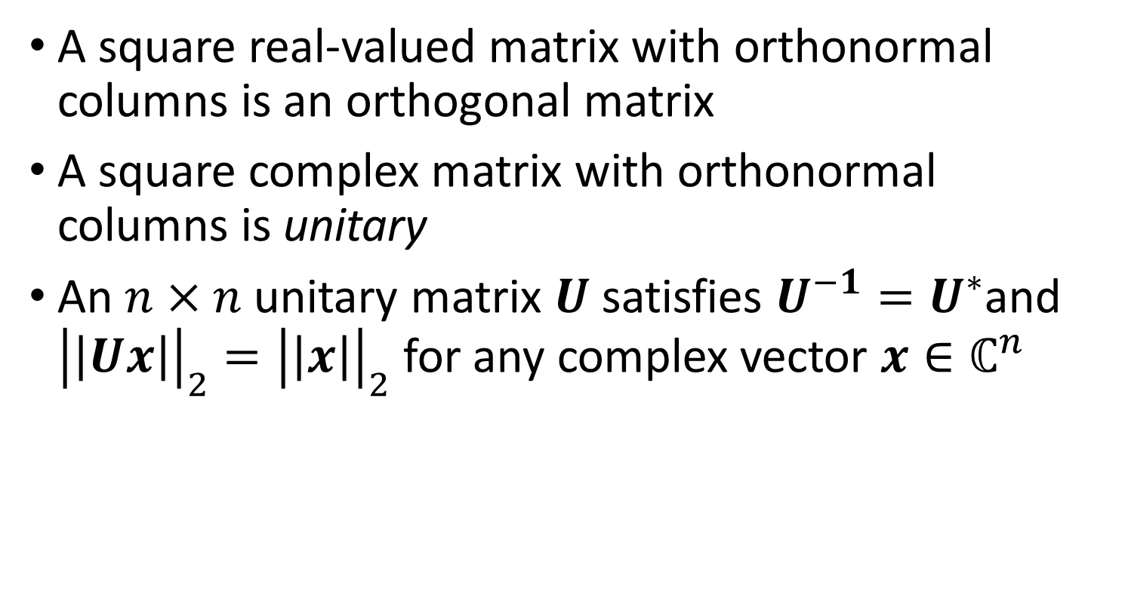
Complex vectors and matrices
A square real-valued matrix with orthonormal columns is an orthogonal matrix
A square complex matrix with orthonormal columns is unitary
An $n×n$ unitary matrix $U$ satisfies $U^{−1}=U^{∗}$and ${\left|\left|Ux\right|\right|}_{2}={\left|\left|x\right|\right|}_{2}$ for any complex vector $x∈ℂ^{n}$

Slide 17
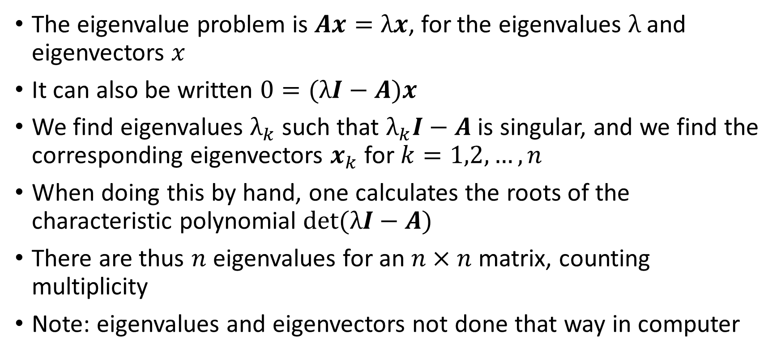
The eigenvalue problem
The eigenvalue problem is $Ax=λx$, for the eigenvalues $λ$ and eigenvectors $x$
It can also be written $0=(λI−A)x$
We find eigenvalues $λ_{k}$ such that $λ_{k}I−A$ is singular, and we find the corresponding eigenvectors $x_{k}$ for $k=1,2,…,n$
When doing this by hand, one calculates the roots of the characteristic polynomial $\det{(λI−A)}$
There are thus $n$ eigenvalues for an $n×n$ matrix, counting multiplicity
Note: eigenvalues and eigenvectors not done that way in computer

Slide 18
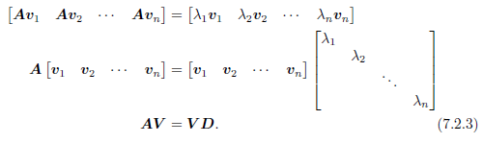
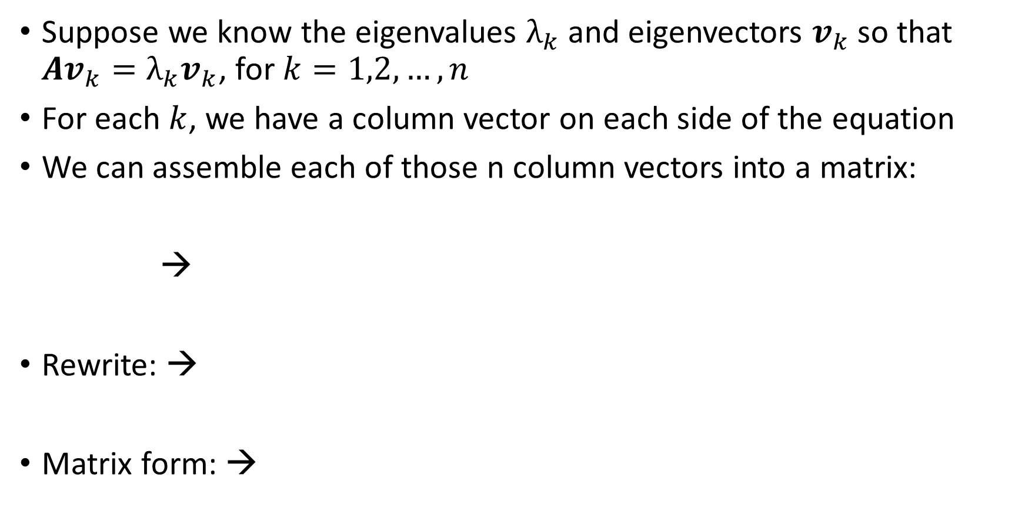
The eigenvalue decomposition
Suppose we know the eigenvalues $λ_{k}$ and eigenvectors $v_{k}$ so that $Av_{k}=λ_{k}v_{k}$, for $k=1,2,…,n$
For each $k$, we have a column vector on each side of the equation
We can assemble each of those n column vectors into a matrix:
→
Rewrite: →
Matrix form: →

Slide 19
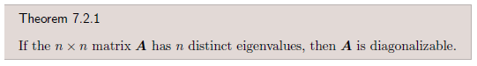
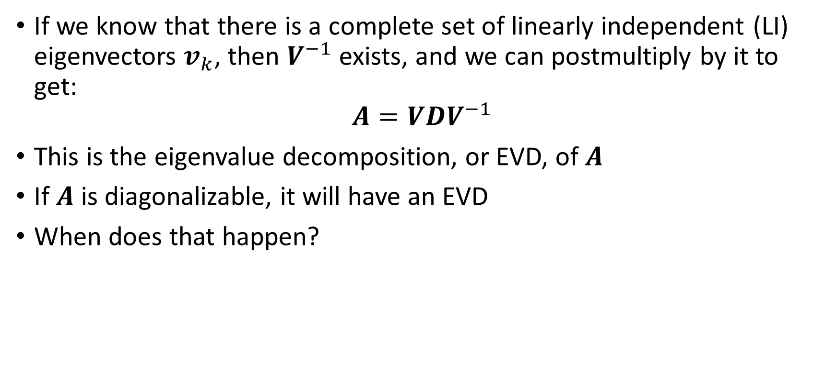
The eigenvalue decomposition
If we know that there is a complete set of linearly independent (LI) eigenvectors $v_{k}$, then $V^{−1}$exists, and we can postmultiply by it to get:
$$A=VDV^{−1}$$
This is the eigenvalue decomposition, or EVD, of $A$
If $A$ is diagonalizable, it will have an EVD
When does that happen?

Slide 20
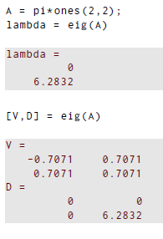
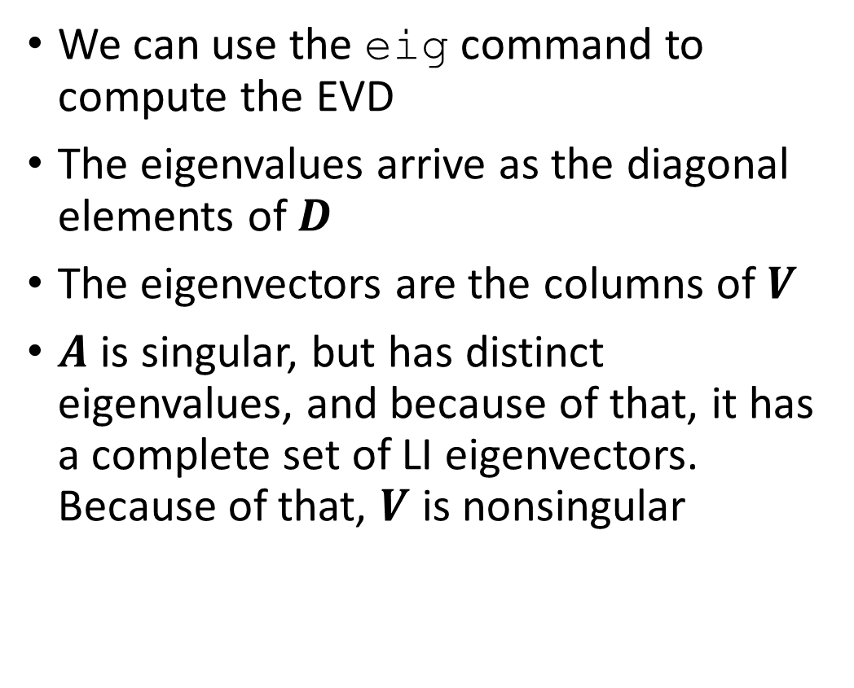
Computing EVD in Matlab
We can use the eig command to compute the EVD
The eigenvalues arrive as the diagonal elements of $D$
The eigenvectors are the columns of $V$
$A$ is singular, but has distinct eigenvalues, and because of that, it has a complete set of LI eigenvectors. Because of that, $V$ is nonsingular

Slide 21
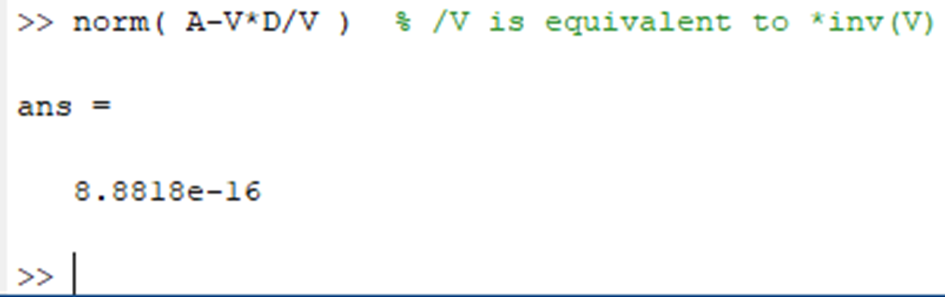
Computing EVD in Matlab
We can easily check that the EVD is equivalent to A:
What if A is not diagonalizable?

Slide 22
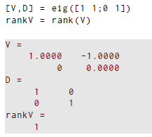
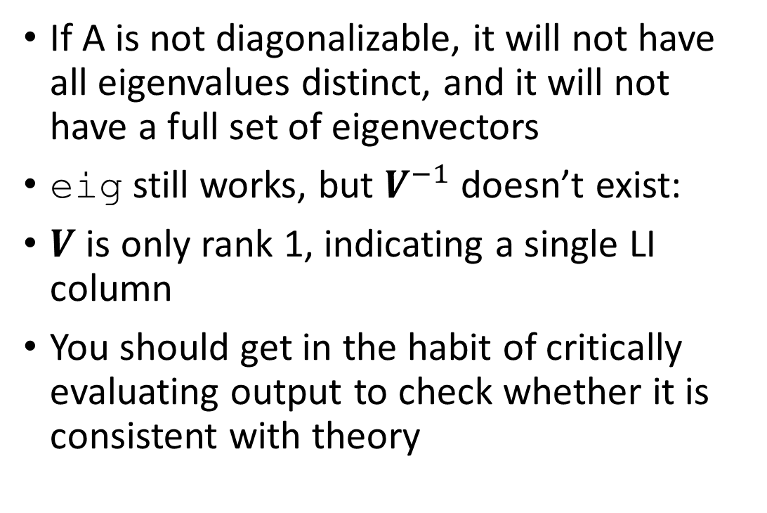
Computing EVD in Matlab
If A is not diagonalizable, it will not have all eigenvalues distinct, and it will not have a full set of eigenvectors
eig still works, but $V^{−1}$doesn’t exist:
$V$ is only rank 1, indicating a single LI column
You should get in the habit of critically evaluating output to check whether it is consistent with theory

Slide 23
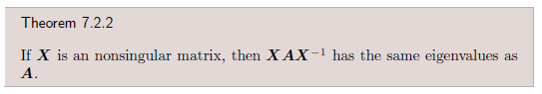
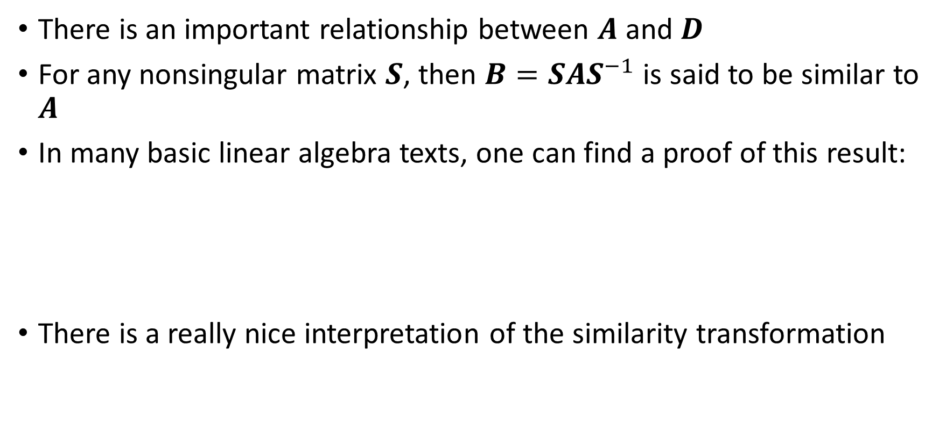
The EVD and similarity
There is an important relationship between $A$ and $D$
For any nonsingular matrix $S$, then $B=SAS^{−1}$ is said to be similar to $A$
In many basic linear algebra texts, one can find a proof of this result:
There is a really nice interpretation of the similarity transformation

Slide 24
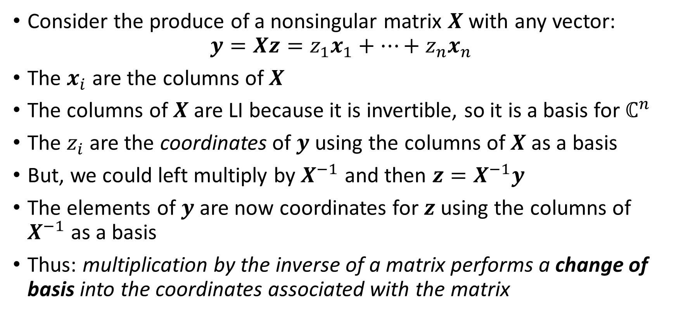
Similarity transformations
Consider the produce of a nonsingular matrix $X$ with any vector:
$$y=Xz=z_{1}x_{1}+…+z_{n}x_{n}$$
The $x_{i}$ are the columns of $X$
The columns of $X$ are LI because it is invertible, so it is a basis for $ℂ^{n}$
The $z_{i}$ are the coordinates of $y$ using the columns of $X$ as a basis
But, we could left multiply by $X^{−1}$ and then $z=X^{−1}y$
The elements of $y$ are now coordinates for $z$ using the columns of $X^{−1}$ as a basis
Thus: multiplication by the inverse of a matrix performs a change of basis into the coordinates associated with the matrix

Slide 25
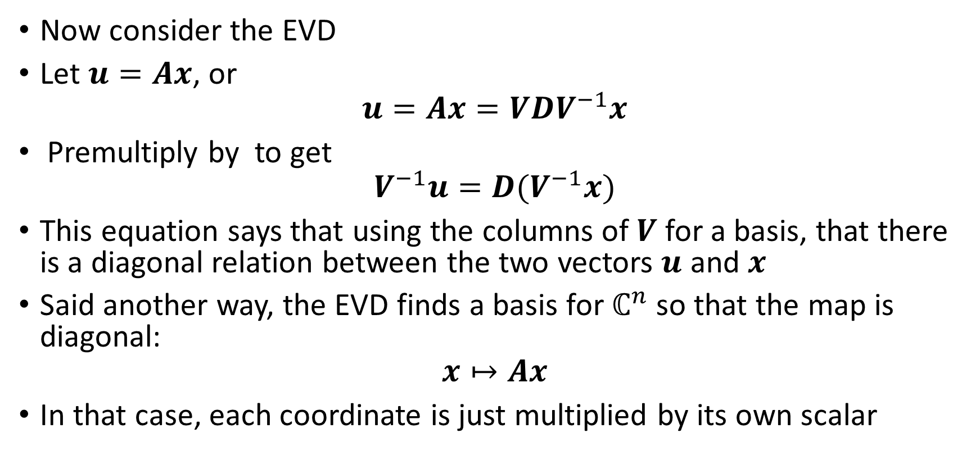
Similarity transformations
Now consider the EVD
Let $u=Ax$, or
$$u=Ax=VDV^{−1}x$$
Premultiply by to get
$$V^{−1}u=D(V^{−1}x)$$
This equation says that using the columns of $V$ for a basis, that there is a diagonal relation between the two vectors $u$ and $x$
Said another way, the EVD finds a basis for $ℂ^{n}$ so that the map is diagonal:
$$x↦Ax$$
In that case, each coordinate is just multiplied by its own scalar

Slide 26
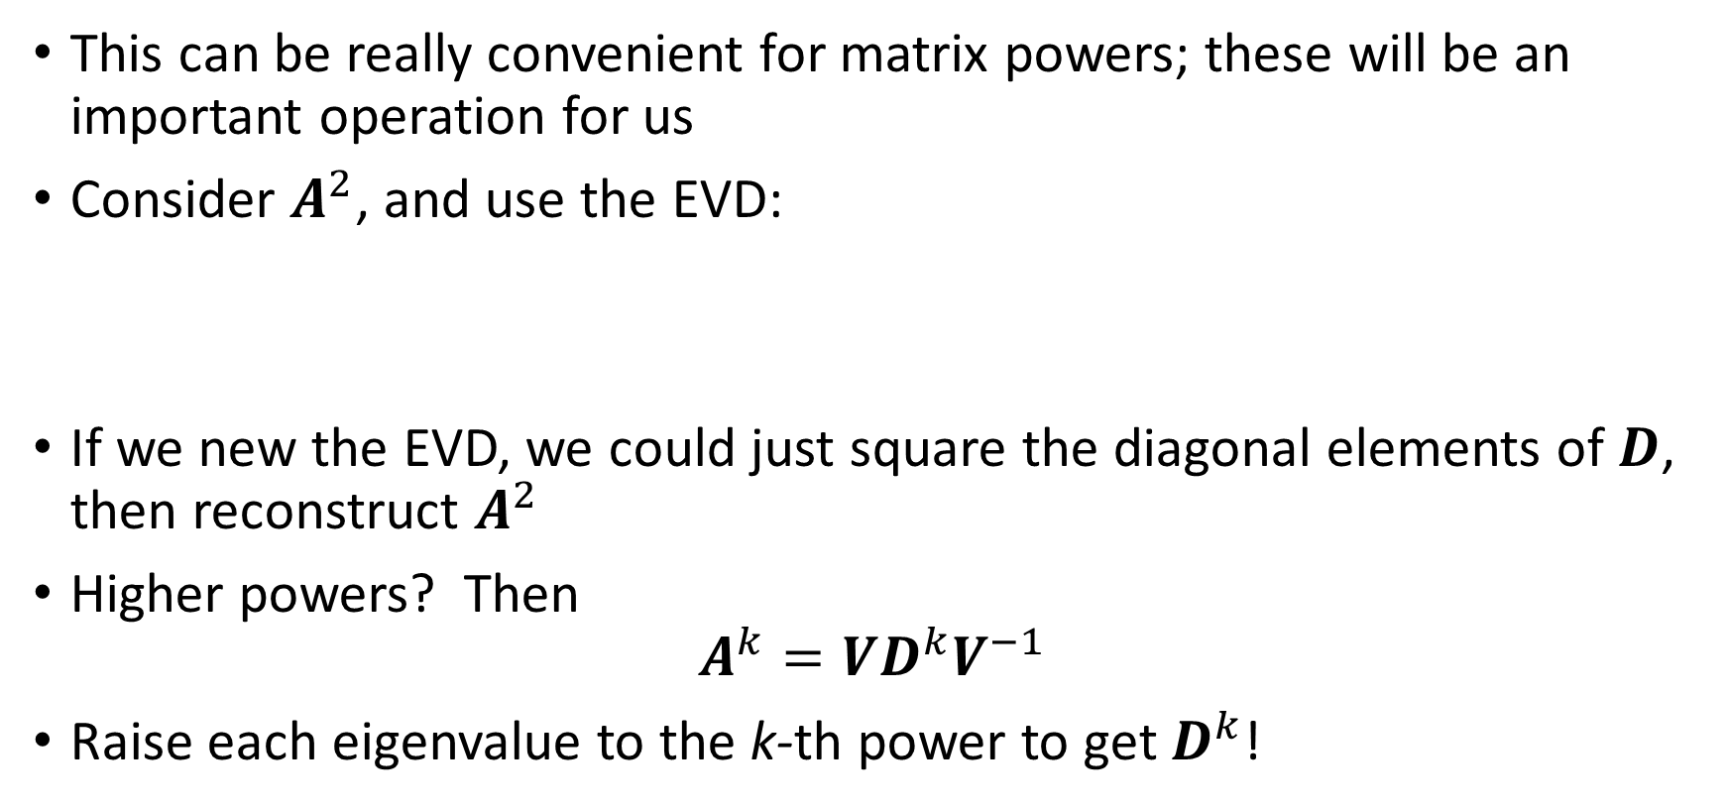
Similarity transformations
This can be really convenient for matrix powers; these will be an important operation for us
Consider $A^{2}$, and use the EVD:
If we new the EVD, we could just square the diagonal elements of $D$, then reconstruct $A^{2}$
Higher powers? Then
$$A^{k}=VD^{k}V^{−1}$$
Raise each eigenvalue to the k-th power to get $D^{k}$!

Slide 27
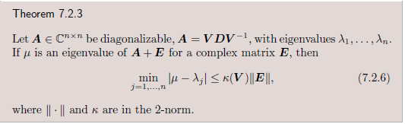
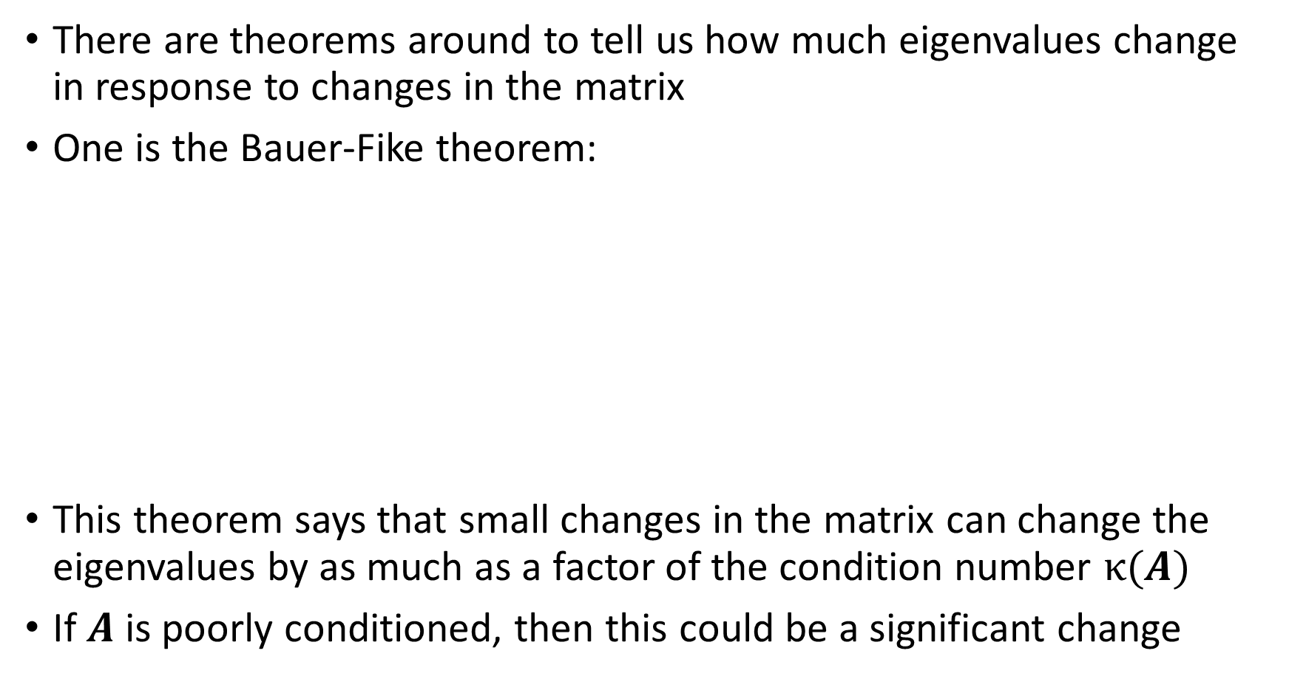
Conditioning of EVD computation
There are theorems around to tell us how much eigenvalues change in response to changes in the matrix
One is the Bauer-Fike theorem:
This theorem says that small changes in the matrix can change the eigenvalues by as much as a factor of the condition number $κ(A)$
If $A$ is poorly conditioned, then this could be a significant change

Slide 28
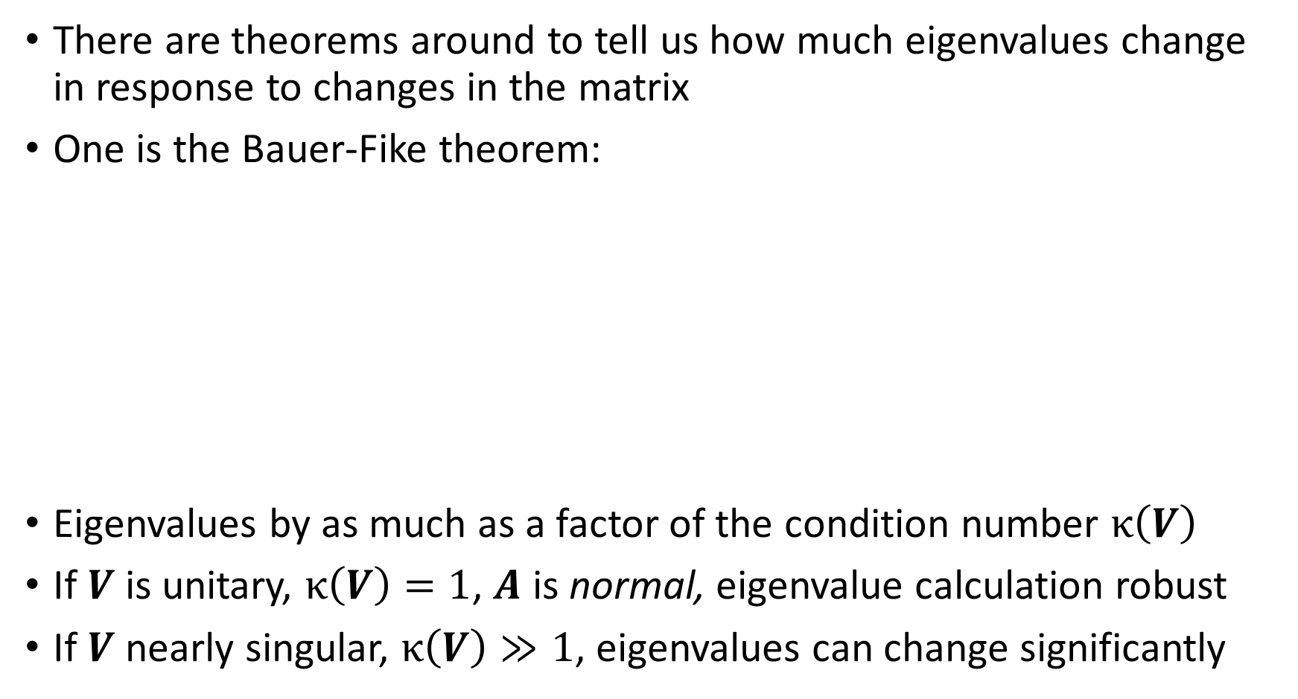
Conditioning of EVD computation
There are theorems around to tell us how much eigenvalues change in response to changes in the matrix
One is the Bauer-Fike theorem:
Eigenvalues by as much as a factor of the condition number $κ\left(V\right)$
If $V$ is unitary, $κ\left(V\right)=1$, $A$ is normal, eigenvalue calculation robust
If $V$ nearly singular, $κ\left(V\right)≫1$, eigenvalues can change significantly

Slide 29
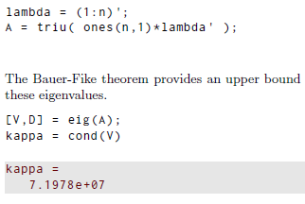
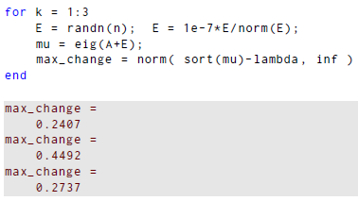
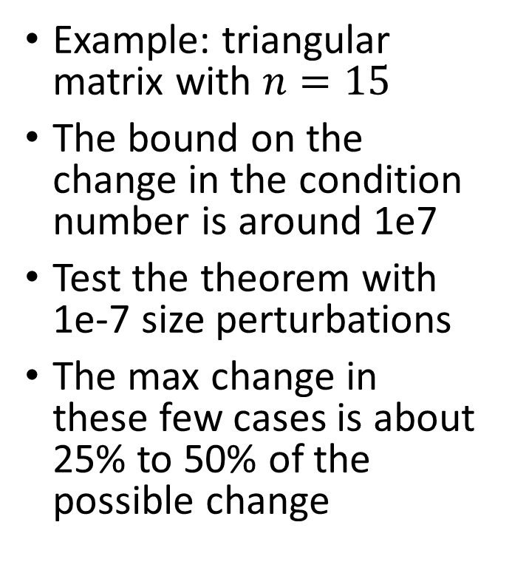
Conditioning of EVD computation
Example: triangular matrix with $n=15$
The bound on the change in the condition number is around 1e7
Test the theorem with 1e-7 size perturbations
The max change in these few cases is about 25% to 50% of the possible change

Slide 30
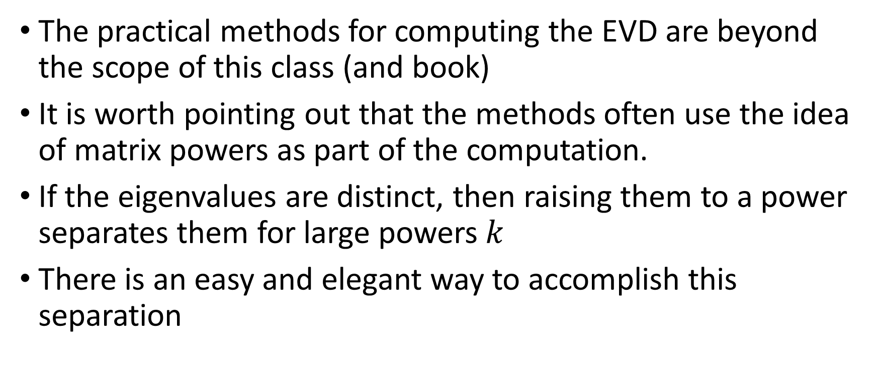
Method of EVD computation
The practical methods for computing the EVD are beyond the scope of this class (and book)
It is worth pointing out that the methods often use the idea of matrix powers as part of the computation.
If the eigenvalues are distinct, then raising them to a power separates them for large powers $k$
There is an easy and elegant way to accomplish this separation

Slide 31
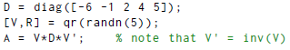
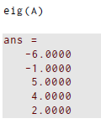
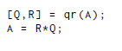
Method of EVD computation
The qr function takes a random 5 by 5 matrix, then returns orthogonal matrix V and upper triangular matrix R
Example: create a matrix with known eigenvalues:
Now do QR factorization and reverse it:
We have same eigenvalues!
A and D are similar

Slide 32
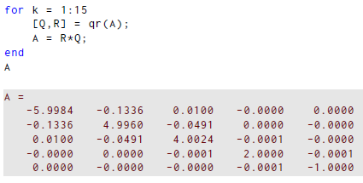
Method of EVD computation
It turns out that we can repeat this and not change the eigenvalues!
This is Francis QR iteration
For this example:
Look at diagonal
elements, and off
diagonal elements
are getting small

Slide 33
Section 7.3 Singular value decomposition

Slide 34
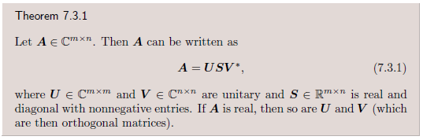
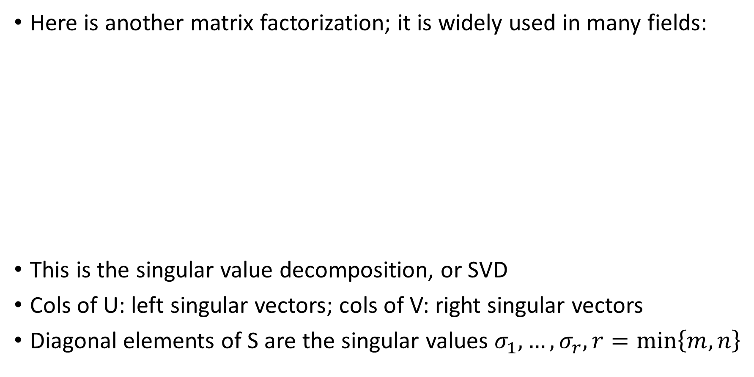
Singular value decomposition
Here is another matrix factorization; it is widely used in many fields:
This is the singular value decomposition, or SVD
Cols of U: left singular vectors; cols of V: right singular vectors
Diagonal elements of S are the singular values $σ_{1},…,σ_{r}, r=\min\left\{m,n\right\}$

Slide 35
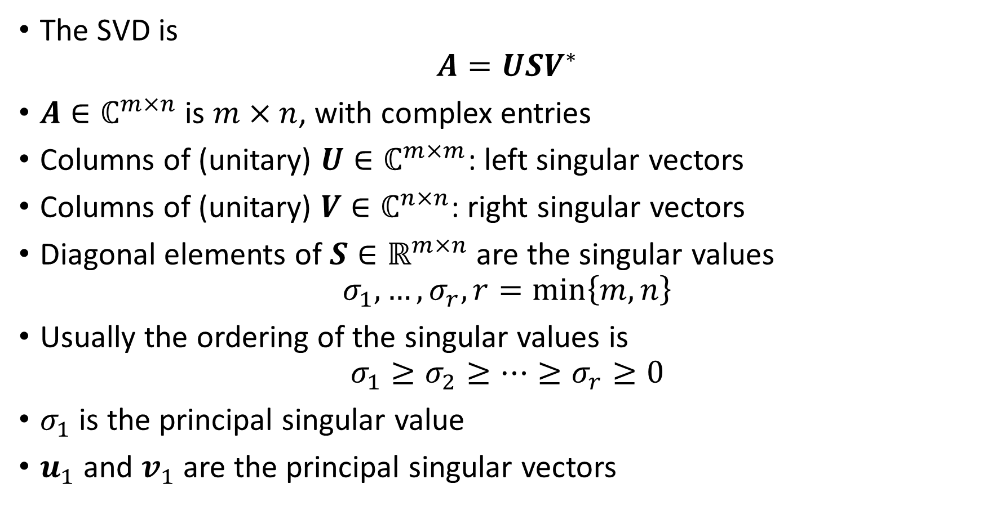
Singular value decomposition
The SVD is
$$A=USV^{∗}$$
$A∈ℂ^{m×n}$ is $m×n$, with complex entries
Columns of (unitary) $U∈ℂ^{m×m}$: left singular vectors
Columns of (unitary) $V∈ℂ^{n×n}$: right singular vectors
Diagonal elements of $S∈ℝ^{m×n}$ are the singular values
$$σ_{1},…,σ_{r}, r=\min\left\{m,n\right\}$$
Usually the ordering of the singular values is
$$σ_{1}≥σ_{2}≥…≥σ_{r}≥0$$
$σ_{1}$ is the principal singular value
$u_{1}$ and $v_{1}$ are the principal singular vectors

Slide 36
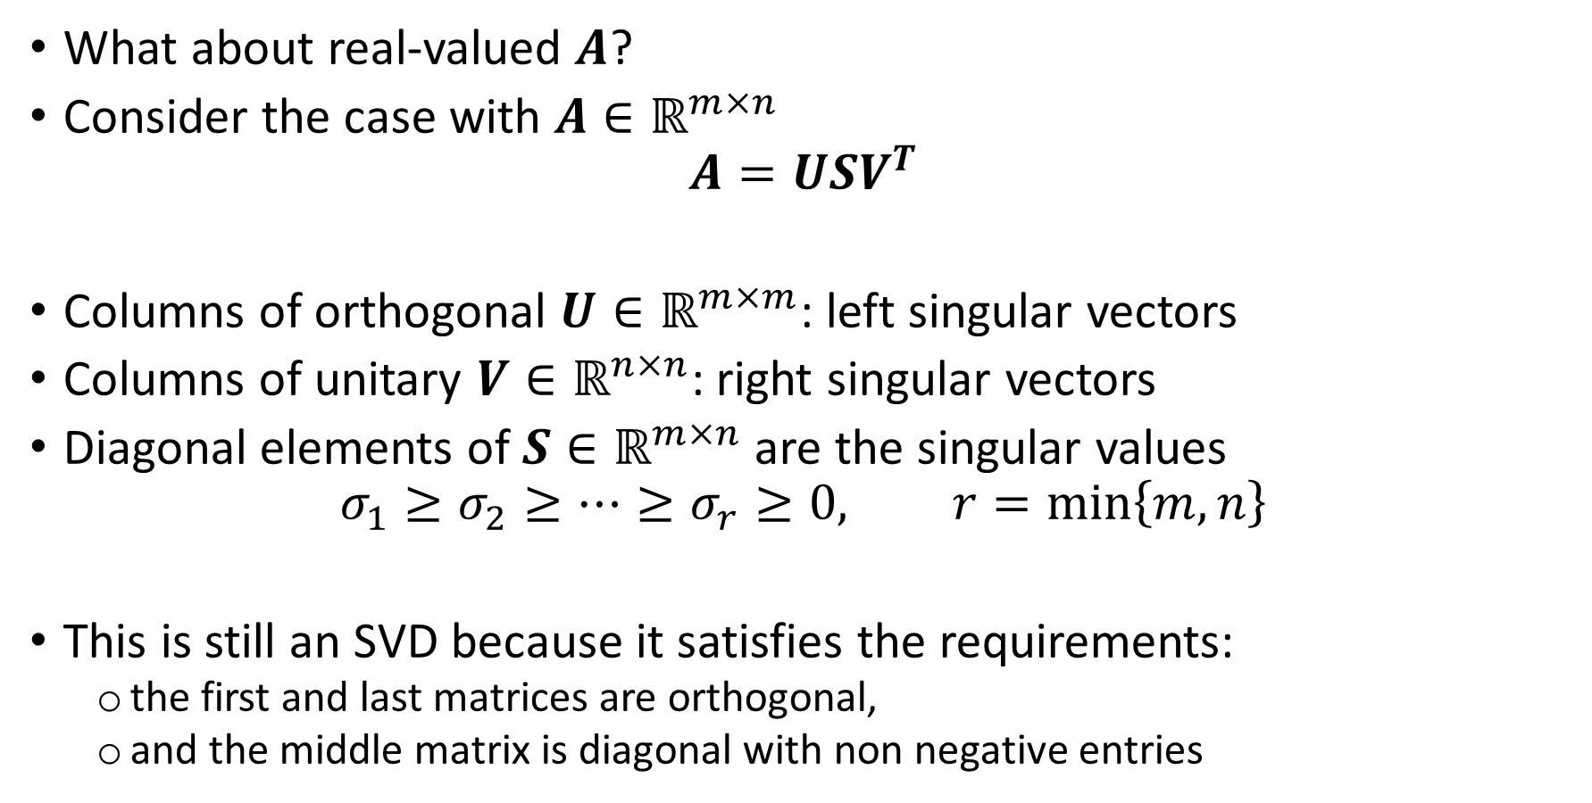
Singular value decomposition
What about real-valued $A$?
Consider the case with $A∈ℝ^{m×n}$
$$A=USV^{T}$$
Columns of orthogonal $U∈ℝ^{m×m}$: left singular vectors
Columns of unitary $V∈ℝ^{n×n}$: right singular vectors
Diagonal elements of $S∈ℝ^{m×n}$ are the singular values
$$σ_{1}≥σ_{2}≥…≥σ_{r}≥0, r=\min\left\{m,n\right\}$$
This is still an SVD because it satisfies the requirements:
the first and last matrices are orthogonal,
and the middle matrix is diagonal with non negative entries

Slide 37
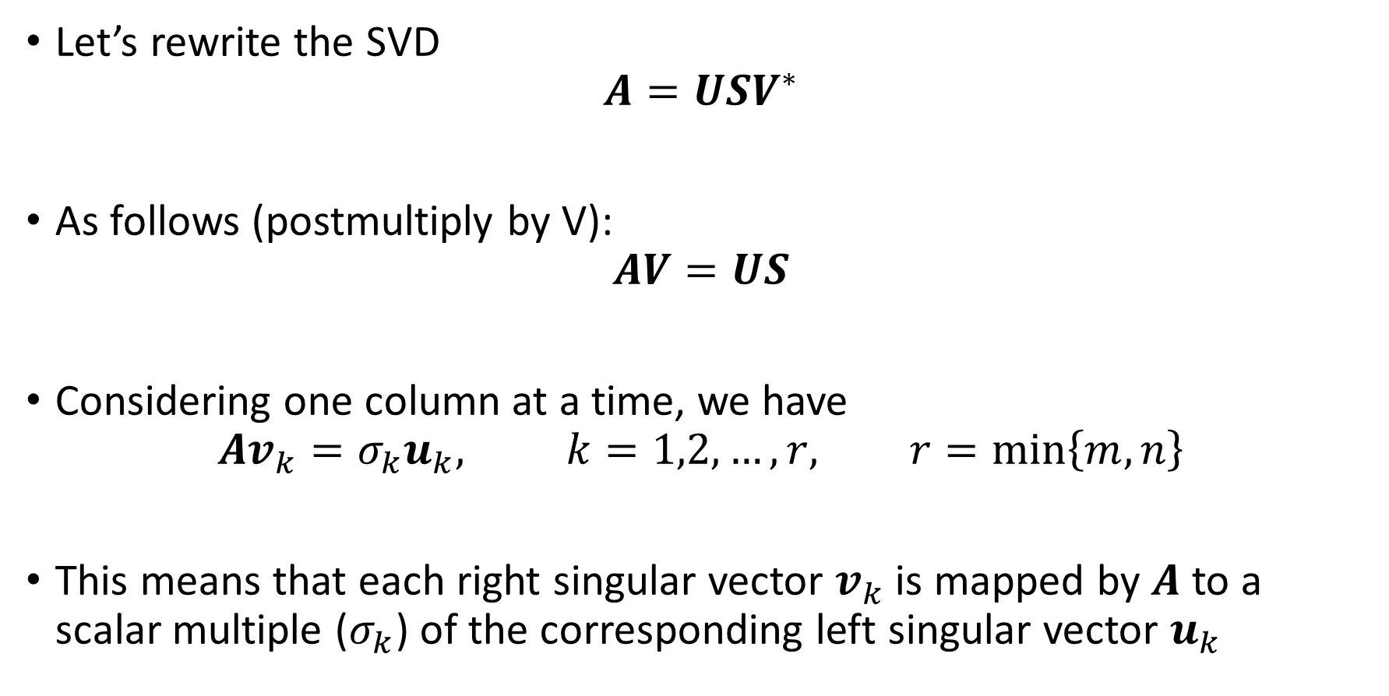
Interpreting the SVD
Let’s rewrite the SVD
$$A=USV^{∗}$$
As follows (postmultiply by V):
$$AV=US$$
Considering one column at a time, we have
$$Av_{k}=σ_{k}u_{k}, k=1,2,…,r, r=\min\left\{m,n\right\}$$
This means that each right singular vector $v_{k}$ is mapped by $A$ to a scalar multiple ($σ_{k}$) of the corresponding left singular vector $u_{k}$

Slide 38
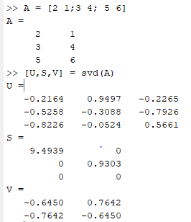


Interpreting the SVD: example
Compute an SVD:
Compare the first column of $AV$ with the first column of $U$: this should be just $σ_{1}$

Slide 39

Interpreting the SVD: visualizing it
The SVD can be visualized for 3x3 real-valued matrices
Unit vectors in the directions of the columns of V (left) are distorted by multiplication by A (right) to

Slide 40

Contrasting the EVD and the SVD

Slide 41

Connection between the SVD and 2-norm (Thrm 7.3.2)
Let $A∈ℂ^{m×n}$ have an SVD with $A=USV^{∗}$ and
$$σ_{1}≥σ_{2}≥…≥σ_{r}≥0, r=\min\left\{m,n\right\}$$
Then:
The 2-norm satisfies ${\left|\left|A\right|\right|}_{2}=σ_{1}$.
The rank of A is the number of nonzero singular values.
The condition number satisfies
$κ\left(A\right)={\left|\left|A\right|\right|}_{2}{\left|\left|A^{+}\right|\right|}_{2}=σ_{1}$/$σ_{r}.$
Division by zero here implies that $A$ does not have full rank. Recall that $A^{+}={\left(A^{T}A\right)}^{−1}A^{T}$ is the pseudoinverse (chapter 3).

Slide 42
SVD example 7.3.2: try it
A=vander(1:5); % Vandermonde matrix
A = A(:,1:4) % 5 by 4 now
[U,S,V] = svd(A);
norm(U’*U-eye(5)) % check U is orthogonal
norm(V’*V-eye(4)) % check V is orthogonal
sigma = diag(S)
[norm(A) sigma(1)] % Thrm 7.3.2, no. 1
[cond(A) sigma(1)/sigma(end)] % Thrm 7.3.2, no. 3

Slide 43


Connections between SVD and EVD
Let $A=USV^{∗}$
Create the square hermitian matrix $B=A^{∗}A$
Then
$S^{T}S$ is a diagonal $n×n$ matrix
There are two cases:
The lower right zero is $n−m×n−m$

Slide 44

Connections between SVD and EVD
There are two cases:
The squares of the singular values of $A$ are the eigenvalues of $B=A^{∗}A$!
Conversely, the EVD of $B$ yields the singular values of $A$ and the right singular vectors of $A$
We could get the left singular vectors from $AV=US$ by doing one column at a time

Slide 45


Connections between SVD and EVD
We could also create
which is $m+n×m+n$
for $A$ $m×n$
If $σ$ is a singular value of $B$, the $σ$ and $−σ$ are eigenvalues of $C$
The associated eigenvector immediately gives a left and right singular vector of $A$
This connection is implicitly exploited by software to compute the SVD

Slide 46




Thin form of the SVD
Like the QR factorization, we can have both full and thin versions of the factorization
Let $A=USV^{∗}$ where $A$ is $m×n$ with $m>n$
Then we can write
Use svd(A,0) to get this in Matlab
Last $m−n$ rows are zero here
$\hat{U}$ is $m×n$, and
$\hat{S}$ is $n×n$, but still same info about $A$ !

Slide 47
Section 7.4 Symmetry and definiteness

Slide 48

Symmetry and Definiteness
When we had real matrices $A$, we found in chapter 2 that there could be specializations of the factorizations there: e.g., $A=LDL^{T}$, where D is diagonal and $L$ is lower triangular
We now study the analogous hermitian case for $A^{∗}=A$
Let $A=USV^{∗}$ where $A$ is $n×n$
Since $S$ is real and square,
$$A^{∗}=VS^{∗}U^{∗}=VSU^{∗}$$
In this case $A$ is diagonalizable with
$$A={VDV}^{−1}={VDV}^{∗}$$
Here $V$ is unitary, and $D$ is diagonal and real
This means that a hermitian matrix has a complete set of orthonormal eigenvectors (a unitary diagonalization), with real eigenvalues

Slide 49




Symmetry and Definiteness: example

Slide 50

Symmetry and Definiteness
Now we have a theorem that says that the condition number for the eigenvalues is bounded above by $κ\left(V\right)$
Here $V$ is the eigenvector matrix
But, it is unitary (or orthogonal), which means that $κ=1$!
So, our last theorem implies that the condition number for a Hermitian or normal matrix is one, which is as good as it gets!
In that case, that is for Hermitian or normal matrices, the eigenvalues can be changed by no more than the norm of the perturbation of the matrix!
Can we verify this?

Slide 51


Symmetry and Definiteness: example
Eigenvalues are 1,2,…,30 and put on diagonal of matrix D
The qr function takes a random 30 by 30 matrix here, then returns an orthogonal matrix V and upper triangular matrix R
The orthonormal columns of V become the associated eigenvectors for the eigenvalues in matrix D, which are the same for A. Why?

Slide 52


Symmetry and Definiteness: example
Create perturbation matrix E that is random and has norm 1e-4

Slide 53

Symmetry and Definiteness
This is great, but it is not quite an SVD
Why? The sign of the diagonal elements could be anything.
Can we make it into an SVD? Yes!
The trouble is with $D$; lets rewrite it as a product of two diagonal matrices: one is $T$ with the sign$(d_{ii})$ on the diagonal; the other is $|D|$, which has $|d_{ii}|$on the diagonal. We still have
$$D=T|D|$$
Substitute to get
$$A={VDV}^{∗}={VT|D|V}^{∗}={(VT)|D|(V}^{∗})$$
This is an SVD, because the diagonal matrix has nonnegative entries and the left and right matrices are unitary

Slide 54

Symmetry and definiteness
Recall the quadratic form $x^{∗}Ax$ where $A$ is $n×n$ and $x$ is $n×1$.
For real entries, $x^{T}Ax$ is the quadratic form of interest
For n=2, we can easily write it out:
$\left[\begin{matrix}x_{1} & x_{2}\end{matrix}\right]\left[\begin{matrix}a_{11} & a_{12} \\ a_{21} & a_{22}\end{matrix}\right]\left[\begin{matrix}x_{1} \\ x_{2}\end{matrix}\right]$=$a_{11}x_{1}^{2}+{(a_{12}+a_{21})x}_{1}x_{2}+a_{22}x_{2}^{2}$
For some matrices, this quantity remains positive for any nonzero vector $x$
For example, if $a_{11}>0,a_{22}>0$, and $a_{21}=−a_{12}$, then the quadratic form reduces to $a_{11}x_{1}^{2}+a_{22}x_{2}^{2}>0$ for nonzero $x$
This matrix is called positive definite
If the matrix were symmetric and this were true, then it is symmetric positive definite or SPD

Slide 55



Symmetry and definiteness
The SPD matrix is important: it has all positive eigenvalues
Complex case: a matrix is Hermitian positive definite (HPD) when
$A=A^{∗}$ and $x^{∗}Ax>0$
for any nonzero compatible $x$
It turns out that we can prove some equivalent statements:
This means, e.g., that all positive eigenvalues implies HPD (or SPD)

Slide 56

Rayleigh Quotient and eigenvalues
In your linear algebra class, you may have discussed the Rayleigh quotient
For $A$ $n×n$ and $x$ $n×1$ with complex entries, the Rayleigh quotient is
$$R_{A}(x)=\frac{x^{∗}Ax}{x^{∗}x}$$
In the special case that x is an eigenvector, say $v$, then $Av=λv$, and substitution easily gives that $R_{A}(v)=λ$
We can conclude that: the Rayleigh quotient maps an eigenvector into its associated eigenvalue

Slide 57

Rayleigh Quotient and eigenvalues
Consider the Hermitian case $A=A^{∗}$ and the Rayleigh quotient
$$R_{A}(x)=\frac{x^{∗}Ax}{x^{∗}x}$$
Put in a vector that is close to an eigenvector: $x=v+εz$ for $ε→0$
Using a multidimensional Taylor expansion gives that
$$R_{A}\left(v+εz\right)=R_{A}\left(v\right)+0+O\left(ε^{2}\right)=λ+O\left(ε^{2}\right)$$
This happens because, for an eigenvector, ${∇R}_{A}\left(v\right)=0$
This means that if the input vector is within $O\left(ε\right)$ of an eigenvector then the Rayleigh quotient is within $O\left(ε^{2}\right)$ of the eigenvalue: $R_{A}$ does a good job of approximating the eigenvalue! Let’s explore this…

Slide 58



Rayleigh Quotient and eigenvalues

Slide 59

Rayleigh Quotient and eigenvalues
Now let’s try different vectors that are closer and closer to an eigenvector
Every time the input vector gets a factor of 10 closer to the eigenvector, there is a factor of 100 improvement in the eigenvalue approximation (another two zeros after the decimal point)

Slide 60
Section 7.5 Dimension reduction

Slide 61


Dimension Reduction
We now return to the SVD
We want to use it to approximate the information in a matrix with much less storage, or many less numbers
We will see a few examples of this
Consider matrix $A∈ℝ^{m×n}$ with $m>n$ (for now)
The thin SVD is then
We truncated the n+1 to m columns of $U$ and rows of $S$ to get $\hat{U}, \hat{S }$

Slide 62





Dimension Reduction
Now let’s rewrite the thin SVD carefully
Note that $\hat{U}$ has orthonormal columns $u_{i}$
$V$ has orthonormal rows $v_{i}^{T}$
$n×n$ here
$m×n$ here
$u_{i}v_{i}^{T}$ is an outer product here, with each forming an $m×n$ matrix

Slide 63



Dimension Reduction
Each of those outer products is weighed with the singular value, then adding them all up recovers the original matrix
But, it so happens that in many matrices, there are only a few singular values that are sizable, and the rest may be quite small.
By convention we ordered the singular values:
$$σ_{1}≥σ_{2}≥…≥σ_{r}≥0$$
So, if the largest few singular values are say $1,2,…,k$, then maybe we need to keep only the first $k$ terms to get a good approximation to the content of $A$!
Let’s make this more precise.

Slide 64


Dimension Reduction
We can think of the process of keeping more singular values as generating a sequence of matrices for increasing $k$, with $1≤k≤r$
Then, we only do a partial sum using the first $k$ terms:
$U_{k}$ and $V_{k}$ are the first $k$ columns of $U$ and $V$
$S_{k}$ is the upper left $k×k$ submatrix of $S$
Because each $u_{i}v_{i}^{T}$ is a matrix with unit norm, the overall size of each matrix added is given by the singular value
Because of this, there are many cases where stopping at a small value of k relative to r will give a v

Slide 65



Dimension Reduction
What do we know about the $A_{k}$ ?
The rank of a sum of matrices is less than or equal to the sum of the ranks of each: thus, the rank of $A_{k}$ is at most $k$
And, it turns out that $A_{k}$ is the best rank $k$ approximation to A!

Slide 66

Dimension Reduction: example
For many matrices, $k$ need not be very large to get a good approximation to the original matrix
Example 7.5.1 gives an example with text
Demo of that example and/or others…

Slide 67





Dimension Reduction: example

Slide 68

Dimension Reduction: example
Look how few singular values are needed to get a decent looking image! Less than 5% of the original storage to get the rank 8 approximation!

Slide 69

Dimension Reduction: example
These low rank approximations can be used to get at the essence of data
One measure of how much content is contained in each added rank is the fractional “energy” given by
Consider a different matrix of information now: Example 7.5.2
Here we look at the voting pattern for the Senate in the 111th session of the US Congress

Slide 70




Dimension Reduction: example

Slide 71



Dimension Reduction: example
The first two singular values account for 75% of the energy
The remaining ones each account for relatively little of the energy
Maybe just those first two are enough to capture the essence of the data?

Slide 72


Dimension Reduction: example
Note the different sizes of the two vectors
Most of the values in these vectors are at $±C$: there is not much in the middle

Slide 73



Dimension Reduction: example
Projecting each senator’s votes in first two V coordinates, the right singular vectors: (1) is partisanship; (2) is bipartisanship
Those coordinates are then plotted against each other
Red: Republican
Blue: Democrat
Black: Independent
The scatter plot suggests that there is a clear separation between parties!

